Slide 1
Reproducibility in an evolutionary context:
Its Ontology and Epistemology
Ken Weiss
Dept of Anthropology
Penn State
July, 2017

Slide 2
Three kinds of reproducibility in genetics
Causal (gene action)
Sampling (significance tests, &c.)
Phylogenetic (animal models)
What should we expect of each?
How often is that actually tested?
Can it be tested?
If not, how confident can we be in our inferences?

Slide 3
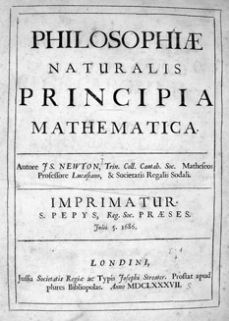
What are scientific ‘laws’? What is ‘theory’?
Science since its foundation in the Enlightenment period 400 years ago has assumed Nature is law-like, the laws are universal, and our objective is to understand those laws, expressed in terms of ‘theory’
As stated by Isaac Newton in his Principia (1687), if Nature is law-like, one can extend what one observes in a particular sample, to all of Nature
Life is a physical phenomenon. But is it law-like in this way?

Slide 4
Euclid, Plato and others identified an essential principle: science seeks abstract general representations of Nature
c
b
a
All right triangles contain 180^{o,}, and a² + b² = c² always!
But there is no such thing as a right triangle! There are only approximations to this ‘true’ relationship.
Note that this kind of theory provides external control and prediction.
We often think in this Platonic way. We refer to ‘the’ human genome, but it doesn’t exist! And we do not have ‘copies’ of it! And it’s not ‘normal’! It is a totally arbitrary abstract reference.
**The universe actually has curvature so these principles don’t hold exactly. But corrections for curvature exist

Slide 5
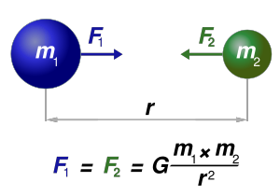
Newton, Galileo et al. introduced the modern concept of ‘laws of Nature’
This led to deterministic, universal equations in mathematical form
This kind of theory provides external control and prediction
Charles Darwin had this kind of view of life, with natural selection the universal ‘law’
**There are some who think that fundamental physical parameters, like G, the gravitational constant, may not actually be constant even within our universe. This may account for the apparent widespread ‘dark matter’. At the very least, the values are close to constant or will obey some other universal ‘law’.

Slide 6
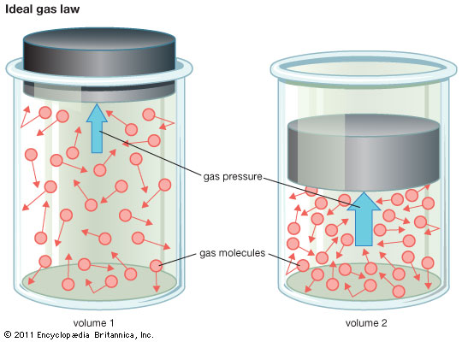
Then came statistics: ‘Laws of Nature’ can be probabilistic.
But the interacting elements are identical and in large numbers
Pressure=Moles x Volume x Temperature
Each identical molecule acts like a deterministic Newtonian ‘billiard ball’, but there are so many that all we can measure is the net collective result, treated in probabilistic terms, and view such laws as probabilistic determinism.
But this theory also provides external control and prediction.
Mendel’s view was that transmission is probabilistic, but causation is deterministic. But what determines the probabilities, if they have specified values? Mendelian transmission has probability p=0.5….except when it doesn’t!

Slide 7
Statistical criteria have become essential for biological inference:
Measurement is incomplete and imperfect
Inheritance is probabilistic (Mendelian transmission)
Reproductive success is probabilistic (fitness)
Mutation and recombination are probabilistic
Some functional effects may be truly probabilistic (antibody variation)
Epidemiological and evolutionary inference are often based on sampling
But most of these probabilisms are not simply based on sampling, yet we have no theory for their specifics.
If Nature is law-like, and we had a valid theory of life, then our data should approach these values asymptotically. That, for example, is the implication of the phrase ‘precision genomic medicine’
But if life evolved as we think it did, asymptotic approaches are perhaps not to be expected! That is because each population, time, species, etc. is different.
‘Sampling’ in biology is permanent: e.g., who does not reproduce cannot be resampled

Slide 8
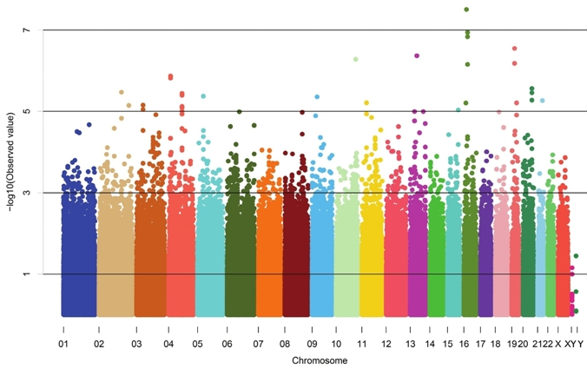
Internal comparative testing is not the same as — and is far less rigorous than inference from an externally derived causal theory
Causal?
Yes!
Hope so
Nah!
GWAS results plot
This is basically retro-fitting to existing data, and in the absence of adequate theory that has no formal way to ensure that its results are predictive other than assuming things won’t change.
Life is an ad hoc evolutionary history of relationships among unique, non-homogeneous polymeric elements (modular sequences, genes, regulatory regions, interaction networks). Each gene, trait, and population is inherently different. That difference is the essence of evolution.
Could life’s causal architecture be not precisely predictable—in principle?

Slide 9
Epistemology: How do we know Nature?
Induction: repeated observations replicate and hence support a hypothesis
Verifiability: you should be able to confirm your hypothesis
Falsifiability: a mistaken idea can be falsified
Deduction from theory: first principles may enable valid prediction
Prediction: if it’s true you should be able to predict future instances
Parsimony: the simplest explanation is best (what justifies this criterion?)
Probabilistic causation: ‘significance’, power, importance
Probabilistic hypotheses: what guesses about Nature seem most plausible?
Who cares??: Use whatever you want!
Gang warfare: Use whatever will get your desired result published!
Note that all of these criteria assume some form of replicability

Slide 10
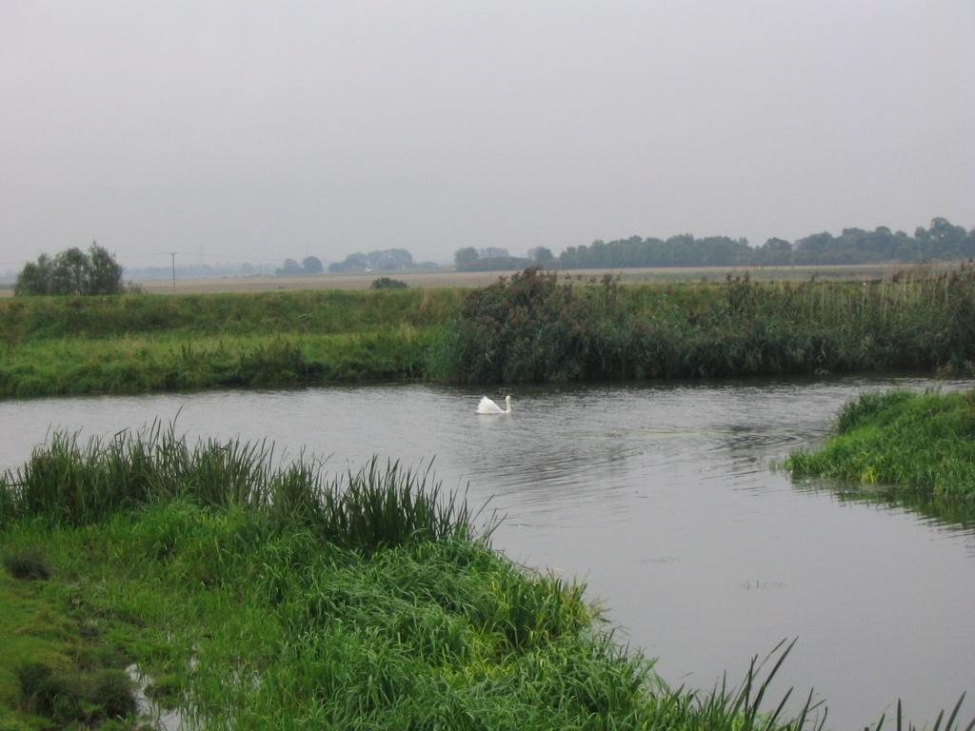
A famous example of the problem with inference by induction:
“All swans are white…..”
River Ouse, Cambridgeshire, 2005 (photo by A Buchanan)

Slide 11
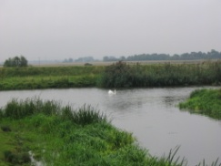
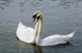





Slide 12
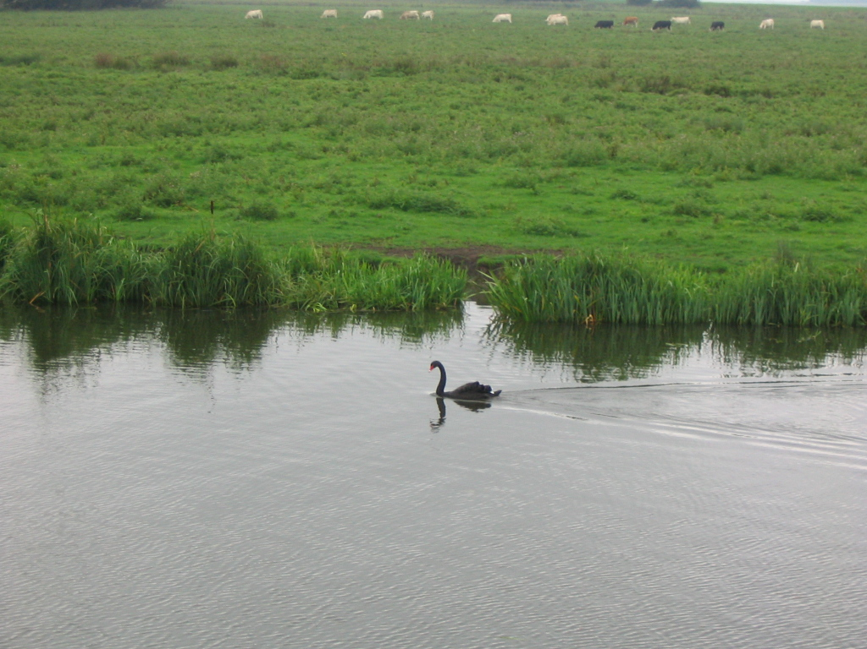
…. until you see one more swan!
River Ouse, Cambridgeshire, 2005 (photo by A Buchanan)

Slide 13
Common responses to the black swan ‘exception’:
Define effects in terms of observations. A ‘swan’ is a white water bird. A black water bird is some other sort of bird.
In genetics, disease can be defined, or studied, in terms of a specific cause, such as variation in a specified gene.
Other outcomes of similar symptoms can be given a different diagnostic name, or called idiopathic phenocopies, but viewed as if they shared the same proximate cause.
Genotyping can be useful for treatment, but can also be used even to raise doubt about whether the person ‘really’ has the disease.
If risks associated with the same genotype vary over time or among samples or populations, how do we explain that?

Slide 14
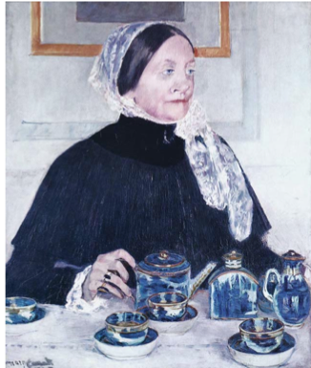
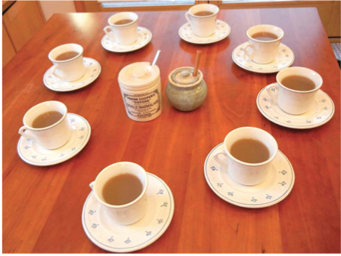
Time for a tea break! After all, tea was the context of statistical significance!
Significance tests are arbitrary and subjective and so are confidence intervals.
But if for evolutionary reasons, populations and samples are not replicable, what use should we make of them?
Milk or tea first?
In the 1920s, British biologist Dr Muriel Bristol tastes 8 cups, half milk first, half tea first. She gets them all right. The chance of that was about 1 in 70 (p~0.014). Could she really tell, or was she just lucky?

Slide 15
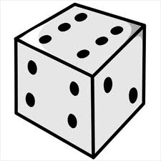
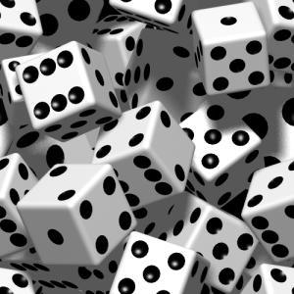
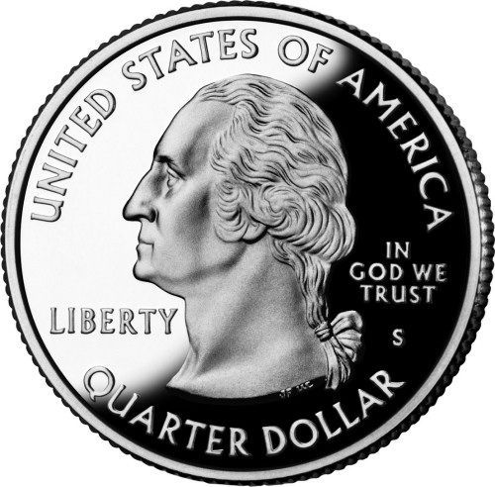
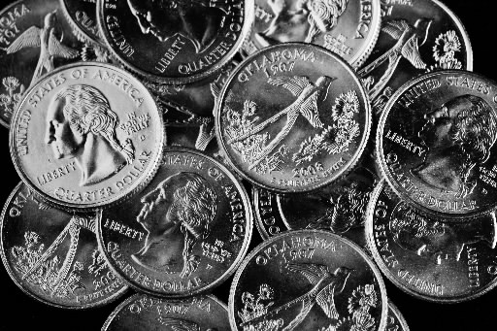
Probabilistic cause, and statistical thinking
Dice and coins: are they fair? Are they identical? Are flips and rolls identical?
Are they really probabilistic?
What do these questions mean? How can you tell?

Slide 16
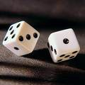
Probabilistic Causation: Rolling Dice
WHAT CAN WE SAY ABOUT A DIE (singular of 'dice')?
SUPPOSE, FOR EXAMPLE, THAT YOU ROLL A DIE AND GET
4
* THIS DIE WHEN ROLLED COMES UP 4
* THIS IS A FAIR DIE
* THIS DIE COMES UP 4 SOME SPECIFIC FRACTION OF THE TIME. WHY?
* THIS DIE HAS SOME TRUE PROBABILITY OF COMING UP 4 (WHAT ABOUT 1, 2, 3, 5, 6?)
* WE CAN'T SAY ANYTHING ABOUT THE DIE
* WE CAN ONLY SAY SOMETHING ABOUT THIS DIE BY LOOKING AT OTHER DICE
How would you know?
If your answer involves the assumption of replicability, what justifies that?
(When and why can that assumption be made about the outcome of a roll of the genetic dice?)

Slide 17
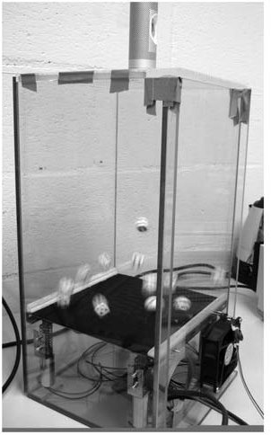
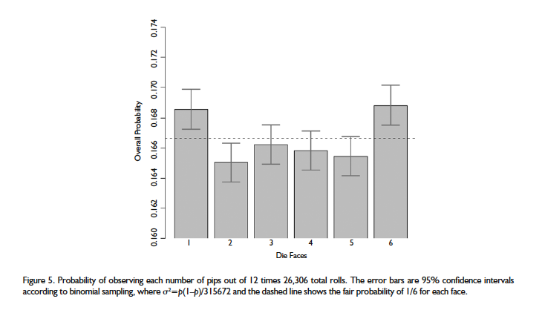
Are dice fair……or not??
This 2009 paper reflects an automated dice-throwing machine, and its results from 26,306 tosses. These results are statistically unclear (as to whether they represent deviation from ‘fairness’), and they do not replicate the heavy-more/light-less face difference! What are we to make of this? How can we know?
“Oh!,” you say, “these results aren’t very different from…. 1/6?”
How many kinds of ‘unfairness’ would you have to test and how?
What do you mean not ‘very’ different? What are the consequences (if any) of that difference?
What if the results were exactly 1/6 for each outcome? Would that prove fairness?
Labby, Z . Chance, 2009 22:11-12

Slide 18
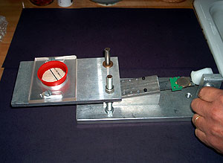
“God does not play dice with the universe” (so, approximately, said Albert Einstein)
A perfect coin-flipping machine would produce the same result every time. Persi Diaconis made one in 2004.
So why does flipping appear to be ‘random’?
And then what does it mean to be ‘fair’ or ‘unfair’?
Since it rotates during its flight, is it only hitting the table that seems ‘random’? Does this mean the table is unfair??
Significance testing is subjective. Can you tell objectively if a coin is ‘fair’? What would that require?
In terms of genetics, how can you tell if a SNP does something or not—for example, if you have it, you get a disease, or you get the disease with a different probability than if you did not carry that SNP? Or at a different age? “The” probability varies among populations, and presumably among individuals….but how could you tell? What would it mean for the prediction to be ‘precise’?
Can an allele be selectively neutral? How could you possibly tell?

Slide 19
It is not entirely obvious what we mean by ‘replicate’
1. Exactly the same result every time we look?
2. The same result some percent of the time (e.g., 1 - p-value fraction?)
3. Almost the same result every time (then what does ‘precision’ mean here)?
4. Results of replications approach some fixed value asymptotically?
5. The gang warfare criterion: what the dominant group decides is ‘true’?

Slide 20
Genetic ‘causation’ is context-dependent
DNA sequence contains ‘information’ for the bearer’s traits
DNA variation is responsible for corresponding variation in those traits.
Genetic function requires interaction, and is context-dependent.
Each nucleotide’s context, or ‘environment’, includes the rest of the genome in that cell, but also many factors beyond that.

Slide 21
The central property of evolution is variation: non-replicability
Functional and regulatory detail can arise by point mutation, that come and go quickly.
New genes and hence new function largely evolve by duplication.
Evolution generates redundancy in genetic causation.

Slide 22
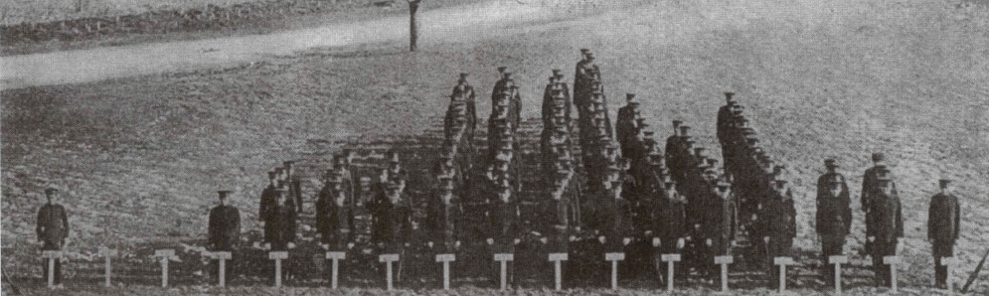
Because of causal redundancy, complex traits exhibit phenogenetic drift and phenogenetic equivalence among samples and populations. Only the trait ‘replicable’. Many loci contribute, most effects too small or too rare to detect.
One contributing gene Two identical contributing genes
Aa
aa aA AA
AAbb
AaBb
AabB
aABb
aAbB
aaBB
Small Medium Large
Aabb
aAbb
aaBb
aabB
AABb
AAbB
AaBB
aABB
AABbcc
AAbBcc
AAbbCc
AAbbcC
AaBBcc
AaBbCc
AaBbcC
AabBCc
AabBcC
AabbCC
aABBcc
aABbCc
aABbcC
aAbBCc
aAbBcC
aAbbCC
aaBBCc
aaBBcC
aaBbCC
aabBCC
A key fact is that individuals with the same trait have different genotypes
aabb
AABB
Small Medium Large
AAbbcc
AaBbcc
AabBcc
AabbCc
AabbcC
aABbcc
aAbBcc
aAbbCc
aAbbcC
aaBBcc
aaBbCc
aaBbcC
aabBCc
aabBcC
aabbCC
aaBBCC
aAbBCC
aABbCC
aABBcC
aABBCc
AabBCC
AaBbCC
AaBBcC
AaBBCc
AAbbCC
AAbBcC
AAbBCc
AABbcC
AABbCc
AABBcc
Aabbcc
aAbbcc
aaBbcc
aabBcc
aabbCc
aabbcC
AABBCc
AABBcC
AABbCC
AAbBCC
AaBBCC
aABBCC
aabbcc
AABBCC
Small Medium Large
Small Medium Large
Three identical contributing genes Many contributing genes
(This presentation assumes equal deterministic effects, 2 alleles per gene, equal frequency, & no error or environment; but the overall conclusion is not affected by these simplifications)

Slide 23
Spooky action at a (very short) distance: complex trans causation
Complex trans ‘communication’ is pervasive within (and among) cells
It involves simultaneity and serially dynamic elements
How does it work?
Are we missing something fundamental?
Can statistical thinking disentangle this or does that confuse epistemology with ontology?

Slide 24
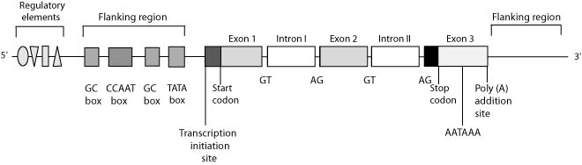
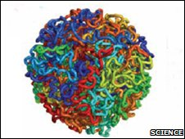
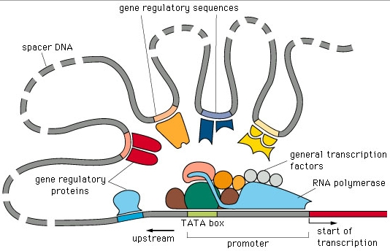
Life is about context: ‘Boolean’ relationships and arrangement:
Genomes are heterogeneous and modular—that’s part of our theory of life.
That means ‘replicability’ is unpredictable in detail
Cis: ‘typical’ gene
(eukaryote)
Cis: Genome contents around a ‘typical’ gene
Trans: Non-linear ‘typical’ chromosome arrangement, and Boolean gene regulation
Regulation
Evolution
Variation
Repeats

Slide 25
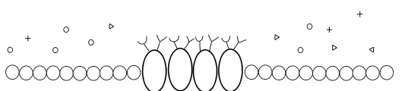
Signaling is a multidimensional Boolean trans phenomenon
The combinatorial action is here. If these are the cells of immediate interest (say, pancreatic cells in diabetics), are they the cells in which expression or epigenetics should be tested?

Slide 26
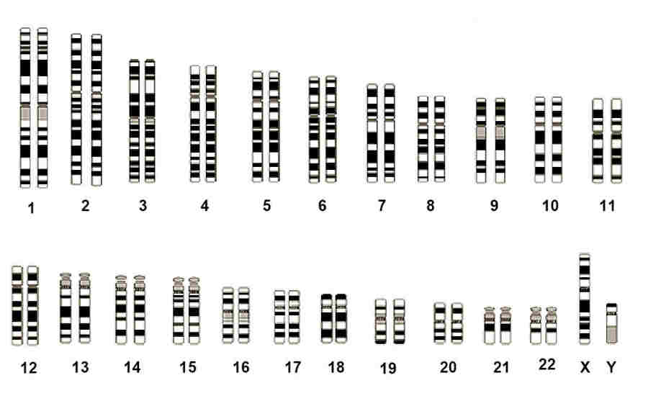
Context: Not all causation in a cell works in cis. Fundamental trans mysteries!
It is not even known how homologous ‘sister’ chromatids find each other to align before cell division. Whatever the mechanism, it must over-ride the similar negative charges of the homologs, and be robust to synteny rearrangements

Slide 27
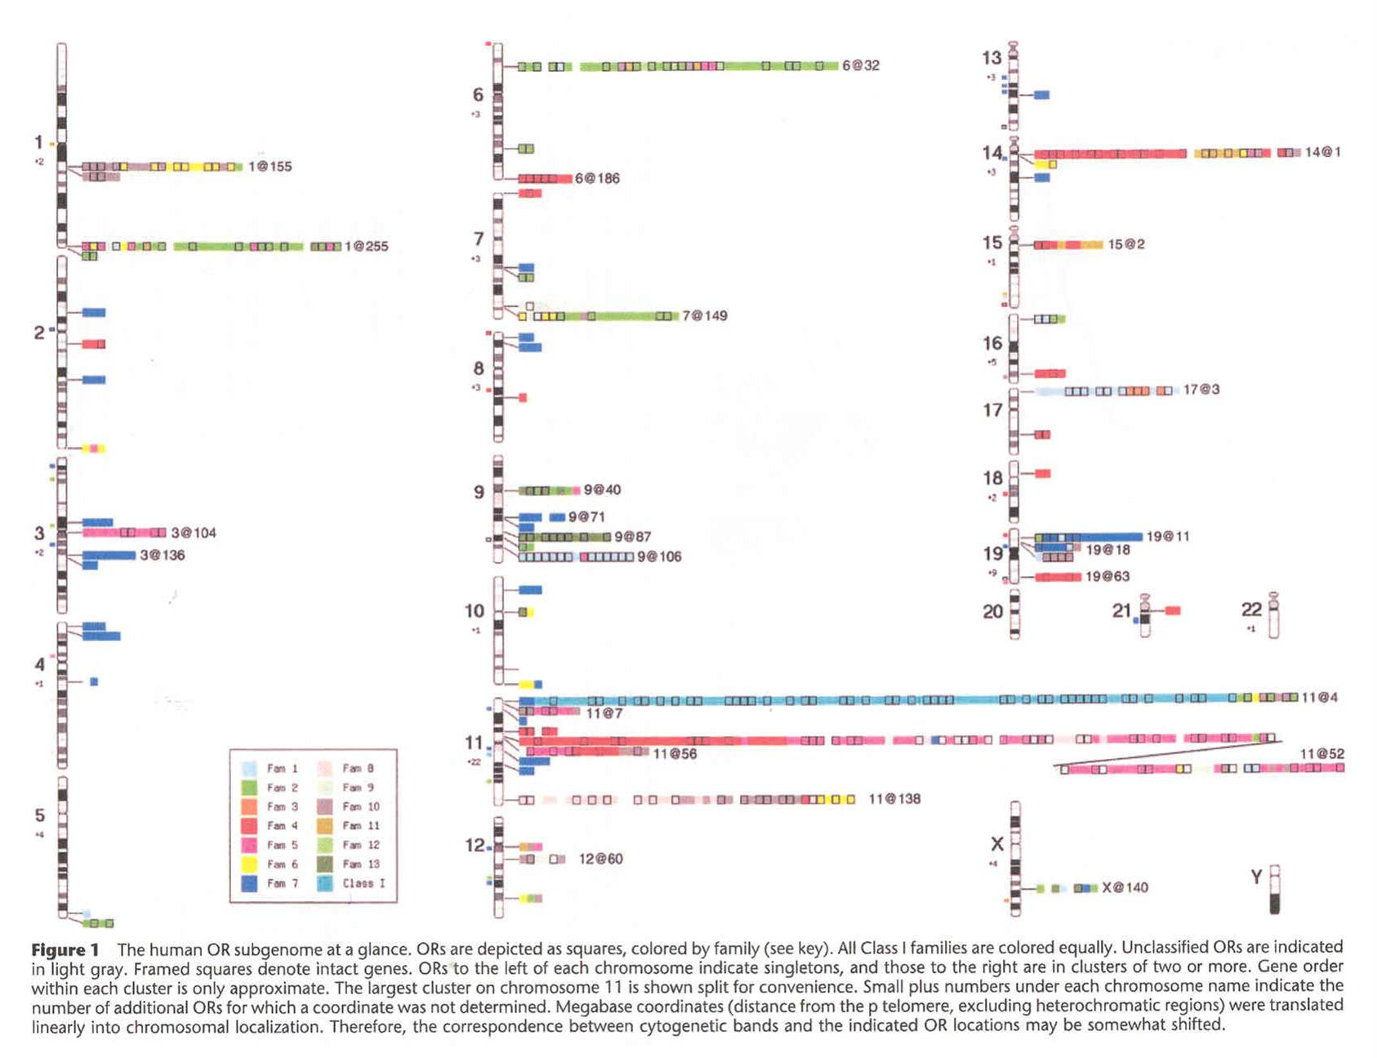
Monoallelic expression: Olfactory Receptor clusters in the human genome
~1000 genes in tandem arrays with some singletons, many (60%) often-polymorphic pseudogenes, and located disproportionately near telomeres in humans and probably in the original vertebrate cluster
(color coding indicates gene subfamilies)

Slide 28
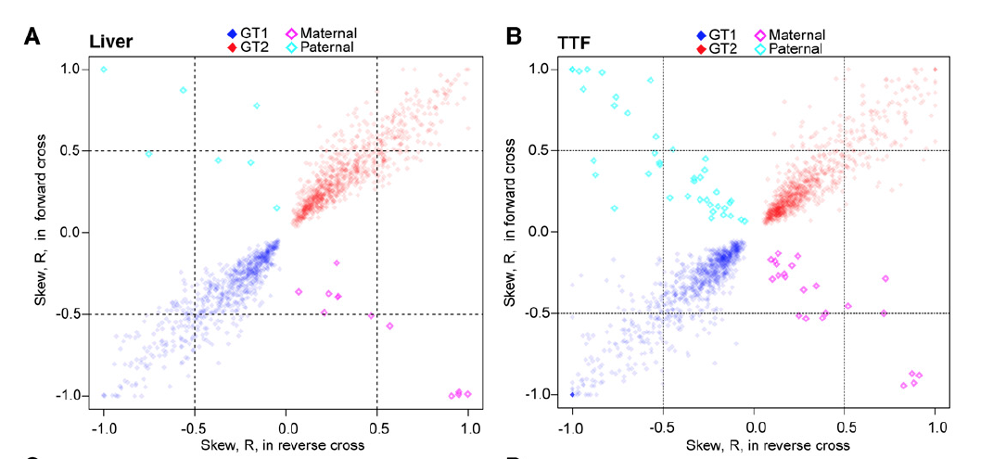
Monoallelic expression seems common. Non-Mendelian inheritance of traits?
Replicable widespread results in a GT1 – GT2 F1 mouse cross:
Dots are the expression-level skew (boxes=imprinted sites. Liver and Tail Tip Fibroblasts (TTF) were tested. Gene-specific results were replicable in crosses in both directions.
Is Mendelian inheritance of traits the diploid ‘law’. . . . except when it isn’t?
Pinter et al. Genetics, June 2015

Slide 29
Profound limits to replicability, and hence to predictability: A fundamental epistemological trap for personalized genomic medicine and evolution
Genotype
Then
Now
Tomorrow
Environmental exposures known or knowable
Environmental exposures not knowable
Possible outcomes
Estimates of risk are retrospective. But the risk we want to know is prospective. Culture-based definitions of traits are also part of the causal landscape.

Slide 30
Higher level taxa
What do we sample? What is ‘the’ genotype?
Species
Animal models
Dog Rhesus Mouse
Populations
Meta-analysis
Europe Asia Africa
Individuals
GWAS
Somatic cells
We typically try to intercept the causal system at one point, rather than deal with its nested generating process as a whole. Can we find better strategies?
Cancer, a few other studies

Slide 31
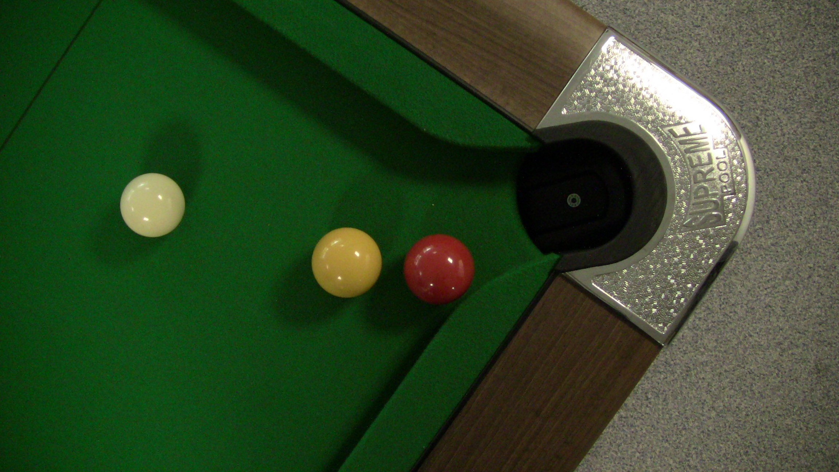
Red ball in pocket! What is the ‘cause’? Who decides what counts?
Do we always know what we mean by ‘cause’? Where does causation ‘start’?
Source: Wikipedia ‘Billiard table’

Slide 32
Some core reproducibility problems
Evolution is about variation, non-replicability
Evolution generates redundancy, but only probabilistically
Most of our inferential tools are based on replicability with proper distributions
Each trait has its own history and characteristics
Analysis of one local subset does not extrapolate automatically to others
Finally . . . .
There are obvious bioethical problems with promises like ‘precision’ genomic medicine—and with making such promises. We might even mislead ourselves, because precision assumes an asymptote towards a true value.
But because we got here by evolution, such values may not exist

Slide 33
Formulating a well-posed question or hypothesis:
Has an answer
The answer is unique to the question
The answer changes in an orderly way with initial conditions
If we can’t form well-posed questions, we can’t expect clear answers.
The usefulness of the answers, or their ‘precision’, may depend on unmeasured or unknown factors, or unstated or untestable assumptions, or misapplied mathematical or statistical methods

Slide 34
THE END.

